Slide 1
Letter KT Agenda

Slide 2
Letter Overview & Fundamental knowledge

Slide 3
Letter Overview
Operation on Letter:
Preview: preview the letter in UI
Accept
Archive to CM system
Send to FAXCORE to be sent to the target hospital
Housekeeping: clean generated letters by time
Receiver: Hospital, Assure, Life Assure, Nominee, Payee
Trigger way:
User Trigger – click button / select option of drop-down in UI
Batch Trigger – run batch service by time
Auto Trigger – Automatically after certain operation finished
Notes:
Different between 3 trigger ways

Slide 4
Letter Stage Distribution
Letters in below diagram can be generated in corresponding stage and after. E.g. Worksheet can be generated in approval stage.
HAS Undertaking Letter
HAS Top Up Undertaking Letter
HAS Deferment Letter
Letter of Decline
Claims Deferment Letter
Final Reminder Letter
Manual-Close Claim letter
Auto-Close Claim Letter
Outstanding Requirement Letter
Pre-existing Condition Letter
HAS Outstanding Letter
Medical Questionnaire
HAS Close Letter
HAS Worksheet
Re-Insurance Letter
FGL
HAS Letter to Policyholder
Claims Payment Letter - Death
Claims Payment Letter - CC
Claims Payment Letter - TPD
Claims Payment Letter - Minor
Claims Payment Letter - Minor (PRUMyChild)
Claims Payment Letter - Minor (PRULady)
Claims Payment Letter - Minor (S&N)
Claims Payment Letter - Minor (Accident)
Admission of Waiver/Payor letter
Claims Repudiation Letter
Instalment Benefit Payment Letter
Instalment Benefit Requirement Letter
Compassionate Allowance
Refund of Premium Letter
Letter-Receipt, Discharge and Indemnity
CC Payment Ltr (Waive of co-ins for PME)
Crisis Cover Plus (Parent) payment letter
PME Co-ins Waiver (No Payout) Ltr
PRUlife income payment letter
Serious Illness Claim Payment
Special Ben Payment
TPD Payment Ltr (Waive of co-ins for PME)
Payment Letter to Hospital
OPCK Limit Exhaustion Letter

Slide 5
Letter Detail
More information of letter criteria in Letter Detail document (SVN):

Slide 6
Entrance Screen for User Trigger Letter

Slide 7
Entrance Screen
Letter list – HAS letters

Slide 8
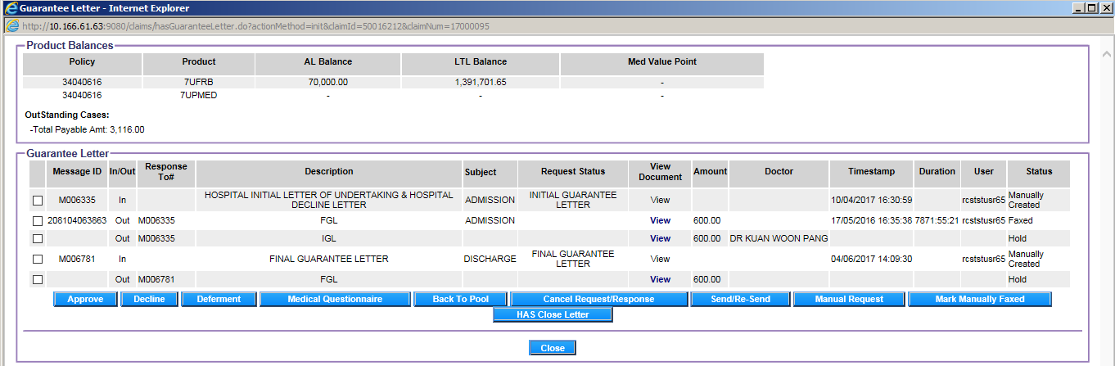
Entrance Screen
Letter list – HAS letters
For IGL, TGL, and FGL generation

Slide 9

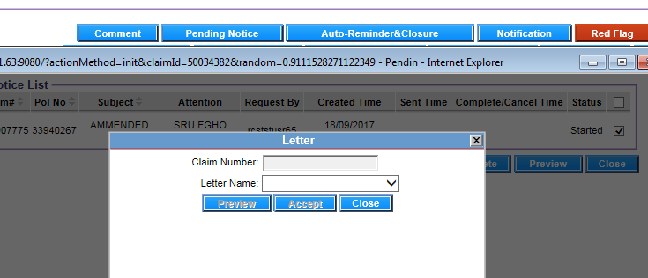
Entrance Screen
Letter list – Outstanding Requirement Letter

Slide 10
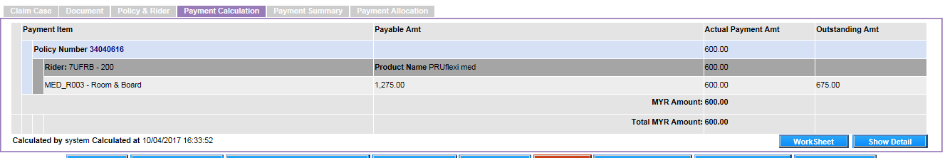

Entrance Screen
Letter list – Worksheet

Slide 11
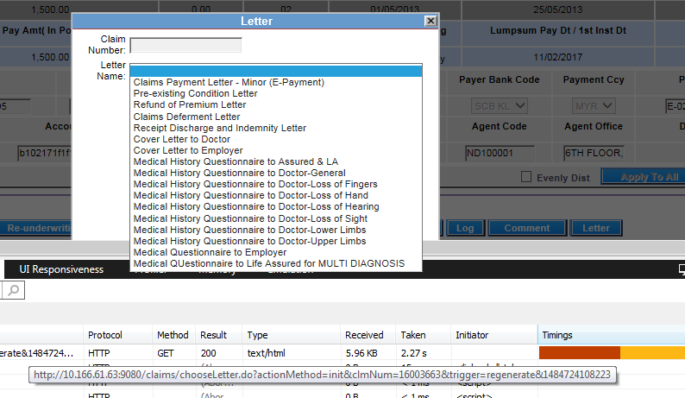
Entrance Screen
Letter list – Common letters, Payment letters & Others letters. The letter button could be seen in normal screen and special function screen

Slide 12
Process Flow of 3 Trigger ways

Slide 13
User Trigger Flow

Slide 14
User Trigger Flow
User will select the letter to print.
If manual data entry is required, user will proceed to enter the necessary data
The letter will be generated by RCS and presented to user for preview
If additional data is required to be entered, user can enter the data and re-generate the letter for preview
If user accepts the letter, user can proceed to manually send the letter to be printed on a connected printer
After user accepts the letter and it is a HAS related letter, RCS will send it to FAXCORE to be sent to the target hospital
The accepted letter will be archived into the CM system

Slide 15
Batch Trigger Flow
Notes:
LA Info will be populated from LA Search.

Slide 16
Batch Trigger Flow
RCS will trigger the batch letter generation by time
The generated letter will saved in a designated folder and also archived into CM system
User will retrieve the generated letter and manually send to be printed on a connected printer
Notes:
^ stand for alternative mandatory field.

Slide 17
Auto Trigger Flow

Slide 18
Auto Trigger Flow
For auto letter, RCS will automatically generate the letter upon performing an action that requires a letter to be auto generated. Example, Fast Track Payment letters and CNA letter
A UI will pop up showing the list of letters generated whereby user can preview or manually printed on a connected printer
The letter will be archived into the CM system

Slide 19
Letter Technical knowledge

Slide 20
Letter Architecture Overview
Application Server
File System
CMS
RCS Core
RCS Batch Framework
Faxcore
RCS Letters
Client
Action Servlet
Struts-config.xml
Struts MVC
Control - M
Letter Action Class
DB
JSP File
Action Form
Jasper Engine jar
Spring
Letter Service Class
Letter DAO Class

Slide 21
User Trigger Technical Design
Letter button
LetterUIAction
LetterUIFilter
Drop-down
Event
OPCKLimitExhaustionAction

Slide 22
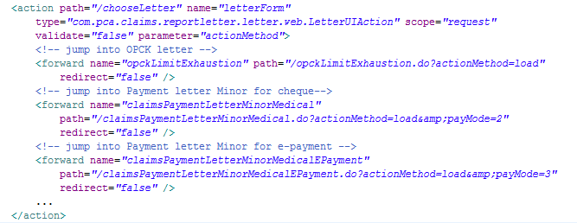
LetterUIAction
LetterUIAction: This class will handle the parameters coming from the user interface and handle the logic in choosing what filter class to use. And it’s as the dispatcher for letters in the drop-down

Slide 23
LetterUIAction
Methods:
init: called by click letter UI button. It will handle the logic of showing the letter UI (drop-down)
load: called by the on-change event in the letter drop down list. It will handle the logic of which page to display
Event function: selectLetterUi(defined in ui-picker.js)
processUIforOutstandingReqLetter: filter letters defined in outstanding group
fillListForLetterRegeneration: filter letters defined in manual and each claim type group which claim case is after approval
checkLetterNamesByClaimType: filter letters defined in manual and each claim type group by different entrances (trigger)
Parameters:
clmNum: Claim Number
trigger: only used when init method called. This param is used to identify which filters should apply
Values: regenerate, pendingNotice, justApproved, justClosed, hasMQ*, hasClose*
letter: only used when load method called. To determine to jump into which initial page of letter
Notes:
http://10.166.61.63:9080/claims/chooseLetter.do?actionMethod=init&clmNum=16003663&trigger=regenerate&1484729529473
http://10.166.61.63:9080/claims/chooseLetter.do?actionMethod=init&clmNum=17007775&claimId=50034382&trigger=pendingNotice&items=76780&claimType=Medical&policies=33940267&1484738008389
http://10.166.61.63:9080/claims/chooseLetter.do?actionMethod=init&clmNum=17007775&trigger=hasMQ-M007217-50034382-388&1484738265425
http://10.166.61.63:9080/claims/chooseLetter.do?actionMethod=init&clmNum=17007775&trigger=hasClose-M007217-50034382-388&1484738351928
http://10.166.61.63:9080/claims/chooseLetter.do?actionMethod=load&letter=claimsPaymentLetterMinorMedicalEPayment&clmNum=16003663

Slide 24
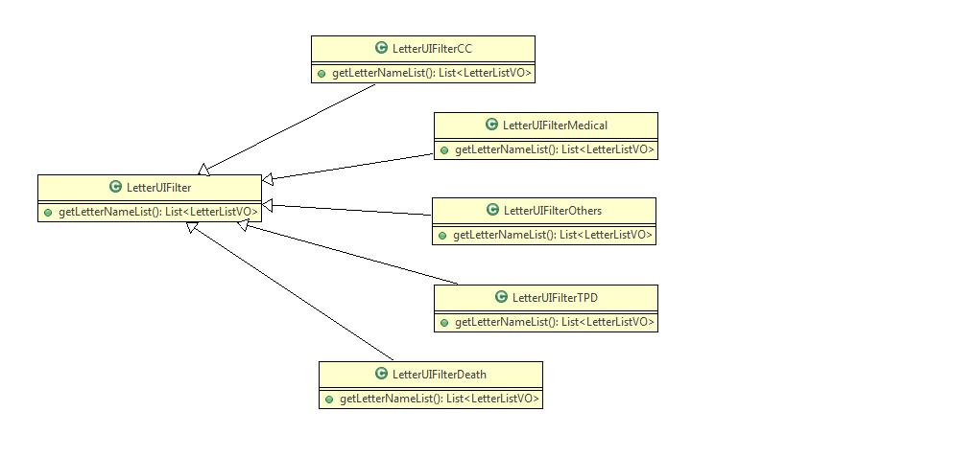
LetterUIFilter
LetterUIFilter Class Diagram

Slide 25
LetterUIFilter
Key points of each claim type filter:
Letter name list defined in reportLetterList.properties
Loop of letter name list
Different filter conditions

Slide 26
Bean and Properties
Bean | Properties | Description
LetterListParams | reportLetterList.properties | Values of letter names, ids, and triggers which are used in filters
ReportLetterParams | reportLetter.properties | Jasper path, letter extension, document id for letter
ReportLetterBatchParams | reportLetterBatch.properties | Jasper path, directory
PurgeLetterParams | purgeLetter.properties | Setting for purge

Slide 27
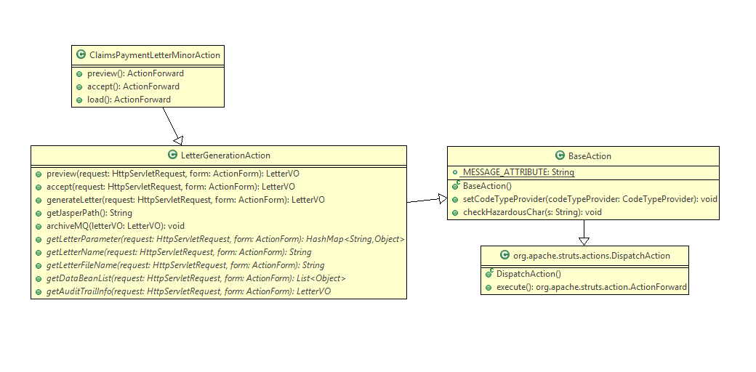
Operation Action
Operation Action Class Diagram

Slide 28
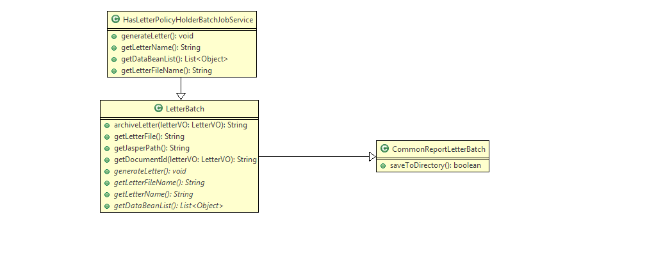
Batch Trigger Technical Design
Letter Batch Class Diagram

Slide 29
Batch Trigger Technical Design
Batch definition table: BATCH
Current running letter batch:
RLCL_HAS: Batch for HAS Auto Reminder and Close letter generation
HASAutoreminderAndHighLightClosureService
DAILY_LETTER: Batch to trigger daily letters generation
DailyLetterBatchJobService
BatchTriggerTool: A tool of manually trigger batch for Testing in SIT / UAT
webservice.url: batch trigger webservice URL
job.*: different batch job

Slide 30
Batch Trigger Technical Design
Switcher of Daily Letter batch generation
ReportLetterAuditTrailDAO.checkEnabledLetterBatch()
select letter_name from LBMT where enabled= 'T';
SIT: HAS Letter to PolicyHolder, Payment Letter Hospital
UAT: HAS Letter to PolicyHolder, Payment Letter Hospital, Instalment Benefit Payment Letter, Instalment Benefit Requirement Letter, E-payment Batch

Slide 31
Auto Trigger Technical Design
GenerateCNALetterService

Slide 32
Archiving
When archiving letter, it will call the CDA (Claim Document Archiving) interface first so as to send the letter detail to CM server. Then CDA will return corresponding id (PID) related to this letter. Meanwhile RCS will store the relation ship between PID and letter detail (e.g. Document ID) into table CCCCDN (DocumentNotification.java)
RCS has a daily CM batch which will call CII (Claim Image Re-indexing) interface to inform CM server to archive CM documents from active folder to archived folder for those Close / End claim cases
LetterGenerationAction: Archiving method for user trigger letter
accept(): Archive letter
LetterBatch: Archiving method for batch trigger letter
archiveLetter(): Archive letter
callCDAInterface(): Call CDA interface to get CM PID
mapArchivedLetter(): Map archived letter to document (PID to Document ID)
DocumentNotification: CCCCDN is used in CM arching batch
CreateDirectoryUtil.createServerDirectory(): Common method to create directory
Notes:
CII (Claim Image Re-indexing) is used to archive CM documents from active folder to archived folder. Once a claim cased is closed, RCS required moving the entire related document to the claim case from active folder to completed folder
CDA (Claim Document Archiving) is used to upload letters which generated in RCS to CM. This function supports both online upload and batch upload

Slide 33
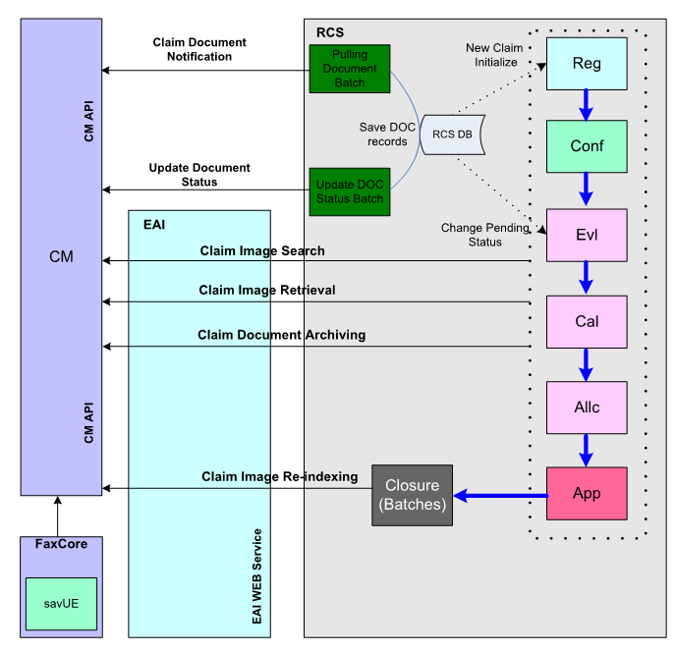
RCS Interfaces
Notes:
CII (Claim Image Re-indexing) is used to archive CM documents from active folder to archived folder. Once a claim cased is closed, RCS required moving the entire related document to the claim case from active folder to completed folder
CDA (Claim Document Archiving) is used to upload letters which generated in RCS to CM. This function supports both online upload and batch upload

Slide 34
Letter Log
RLAT: Letter Generation Log table. Only when archiving is successful would it add the log record
LetterGenerationAction.logGeneratedLetter()
CommonReportLetterBatch.logGeneratedLetter()
RLOR: Outstanding Requirement Letter Log table
Notes:
CII (Claim Image Re-indexing) is used to archive CM documents from active folder to archived folder. Once a claim cased is closed, RCS required moving the entire related document to the claim case from active folder to completed folder
CDA (Claim Document Archiving) is used to upload letters which generated in RCS to CM. This function supports both online upload and batch upload

Slide 35
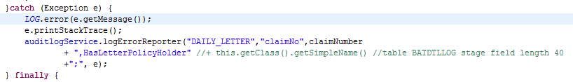
Notification of Generation Error
Error Log service: AuditlogService
Error log record table: BATDTLLOG
RCS has an email notification batch which is used to gather these error log and send them to corresponding user by email

Slide 36
Housekeeping
Batch: PURGE_LETTER – DailyPurgeLetterBatchJobService
Files extension: PDF, TXT
purgeLetter.properties
server.foldernames=HAS;NONHAS;GL
purge.days=10;7;10
claims.home/HAS | Files modified date < system date – 10 days
claims.home/NONHAS | Files modified date < system date – 7 days
claims.home/GL | Files modified date < system date – 10 days
Currently this batch is not working due to PAMBPROD-356 and PAMBPROD-1141

Slide 37
Letter Standard
Font and Paragraph Formatting
Letter DOC ID
Classification of Letter
Letterhead Usable Area
Envelop Window Clearance
FAXCORE
Carbon Copy section (Agent)
HAS Letter Special Standard

Slide 38
Font and Paragraph Formatting
The following table list the font and spacing that is to be applied to as the default letter formatting:
 | PAMB
Font Type: | Arial Regular
Font Size: | 10pt
Paragraph Spacing: | 1 line
DOC ID Font Type and Size: | Courier New; font size - 14pt
DOC ID Box Size | 15mm x 40mm
Spacing after colon (where claim no, policy no is) | 9mm
Notes:
1in = 2.54cm = 25.4 mm = 72pt = 96px (windows)

Slide 39
Letter DOC ID
All letters generated by RCS should include the DOC ID numbering in the letter. RCS will need to print the DOC ID on all letters.
For letters that send out via FAXCORE, DOC ID will be printed on every page.

Slide 40
Classification of Letter
All letters generated by RCS should include the document classification at the top of the letter.
English version: RESTRICTED (All letters to be UPPERCASE) and aligned to LEFT
Malay version: TERHAD (All letters to be UPPERCASE) and aligned to LEFT
RCS will need to print the classification wording on all letters.

Slide 41
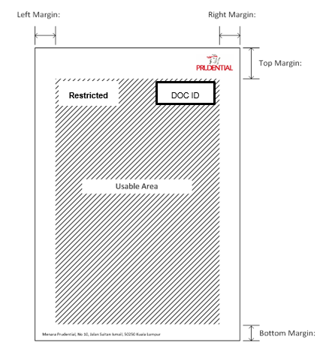
Letterhead Usable Area
Letter content will be printed within the area marked as “Usable Area”.

Slide 42
Letterhead Usable Area
The following margin borders are to be left blank. No letter content will be printed within these margins.
 | PAMB
Top Margin: | 40mm
Bottom Margin: | 35mm
Left Margin: | 20mm
Right Margin: | 25mm

Slide 43
Envelop Window Clearance
To cater for letters that will be inserted into envelops with a see-through window for the mailing address, the following describe the zones where the address will be printed on.

Slide 44
Envelop Window Clearance
The following zones defines the envelop window clearance area.
 | PAMB
Top No Print Zone: | 0.5cm
Bottom No Print Zone: | 0.5cm
Max Height of Envelop Window Clearance Zone | 2.5cm
Max Width of Envelop Window Clearance Zone | 9.3m

Slide 45
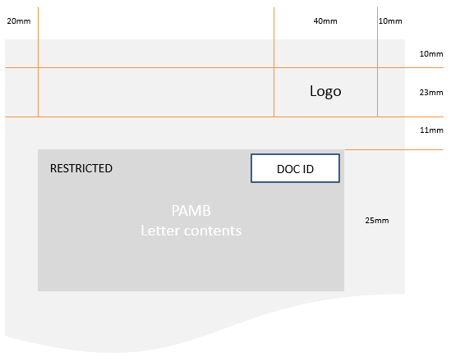
FAXCORE

Slide 46
Carbon Copy section (Agent)
The Carbon Copy (CC) section displays the Agent information selected in the Receiver flag field from the Payment Allocation screen.
If servicing agent is selected:
Only active servicing agent will be displayed. If servicing agent is no longer active, display the Agency Leader information. If Agency Leader is no longer active, display blank
If multiple policies are associated with the claim case, there could be multiple agents. All agents must be displayed under the CC section
For sole agent serving multiple policies, agent information will only be displayed once
If Branch PIC (Person-in-charge) is selected
Display “Branch PIC” in agent name
Display agent code as blank
If Payee is selected in the Receiver flag, the CC section in the letter is blank.

Slide 47
Carbon Copy section (Agent)
Basic script for CC: ReportLetterConst.AGENT_CC_BASE
Common Service: ClaimPaymentDetailService
getAgentCCList(String claimNumber, String payeeClientName)
getAgentCCListPolicy(String claimNumber, List<String> policyNumber)

Slide 48
HAS Letter Special Standard
Applicable to the following HAS Letters only
Undertaking Letter
Top up Undertaking Letter
Deferment Letter
Letter of Decline
All the other requirements should follow the Overall Letter Layout except specified.
Font & Paragraph Formatting:
Letterhead Usable Area:
 | PAMB
Font Type: | Arial Regular
Font Size: | 8pt
Paragraph Spacing: | 1.15
 | PAMB
Top Margin: | 20mm
Bottom Margin: | 5mm
Left Margin: | 20mm
Right Margin: | 20mm

Slide 49
HAS Letter Special Standard
For Undertaking & Top up undertaking letter to be in 1 letter, general remark and exclusion remark will have to be limited to 3 lines respectively. Otherwise, it will flow to the 2nd page.
For Decline & Deferment letter to be in 1 letter, Decline & Deferment reasons will have to be limited to 3 reasons only. Otherwise, it will flow to the 2nd page.
Letterhead Usable Area to start in line with Prudential logo. Refer to the sample below.
Sample:

Slide 50
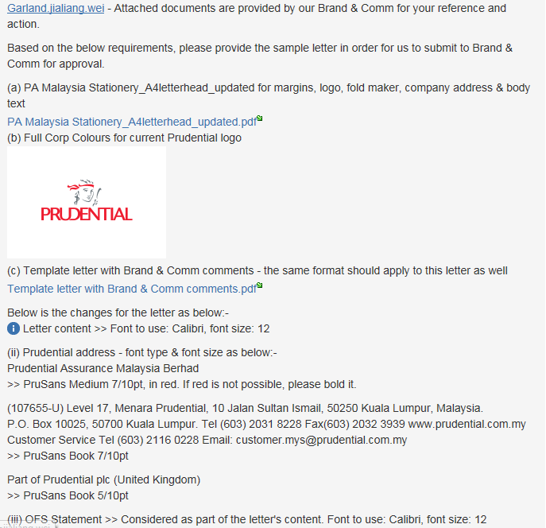
New Letter Standard
PAMBPROD-1237

Slide 51
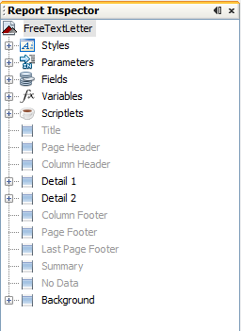
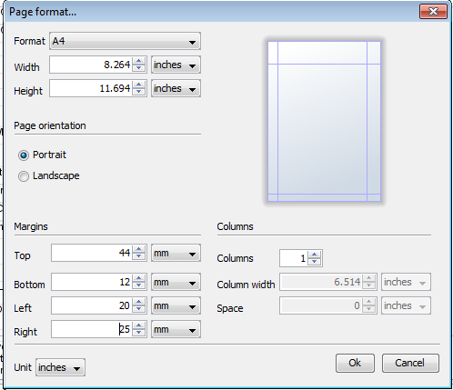
Jasper Development
Creating the Letter template
Right-click the Letter name under Report Inspector → Page Format
Adjust the margins according to the required letter margin formatting as defined in the Overall FSD.
For PAMB, margins are 44mm, 12mm, 20mm, 25mm as shown in the example

Slide 52
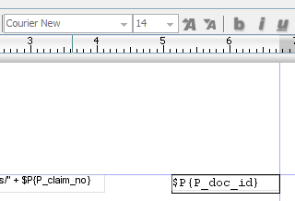
Jasper Development
The DOC ID should be set to Font : Courier New and its font size to 14
Adjust the margins according to the required letter margin formatting as defined in the Overall FSD.

Slide 53
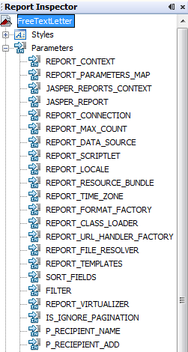
Jasper Development
To create parameters to push data from the UI: Right-click on the Parameters under the Report Inspector and click add Parameter
Always start your parameter with “P” to make it easier to differentiate if a field in the template is a Parameter, a Field or a Variable

Slide 54
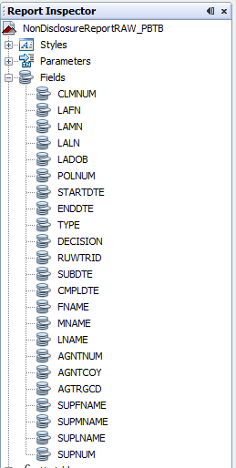
Jasper Development
The fields that you queried from the database will automatically be displayed under Fields

Slide 55
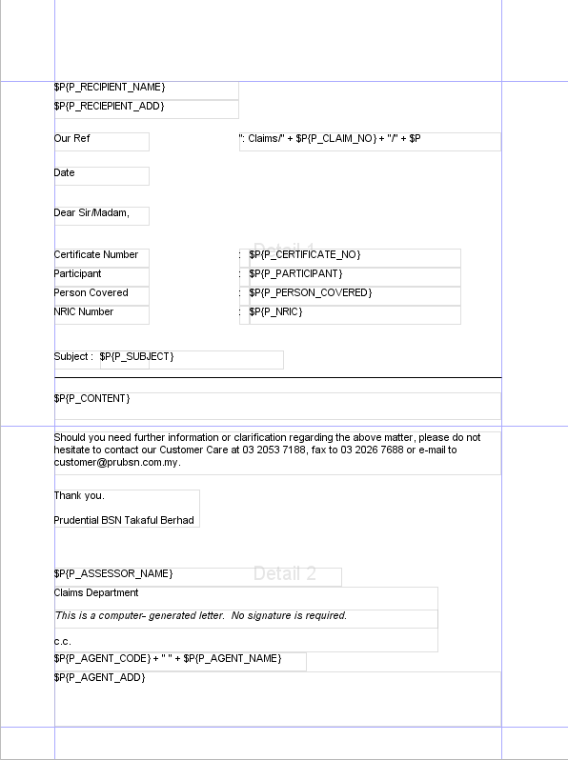
Jasper Development
To start the design on your report template, drag the Parameter (if the field to be displayed will come from the UI)

Slide 56
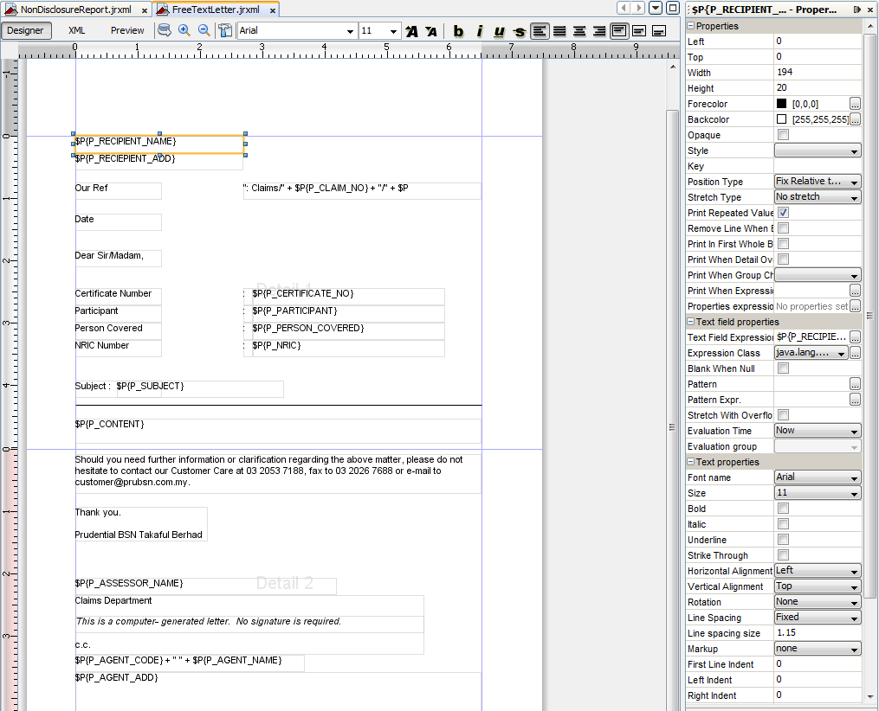
Jasper Development
To edit the font to the required font format, clicking on the field you have already dragged on the letter template will enable the fields properties to be edited on the right pane under the Text Properties. Refer to the Overall FSD for the proper format settings.

Slide 57
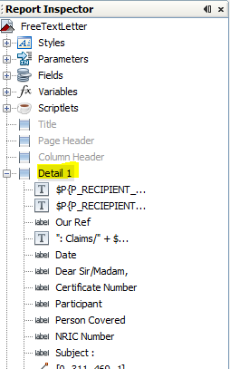
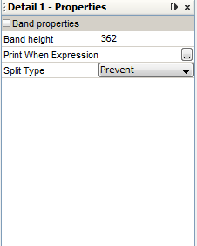
Jasper Development
A long paragraph should not be break to a next page. Instead, the whole paragraph should be in the next page
To prevent splitting, click on the band and set its properties to Split Type - Prevent

Slide 58
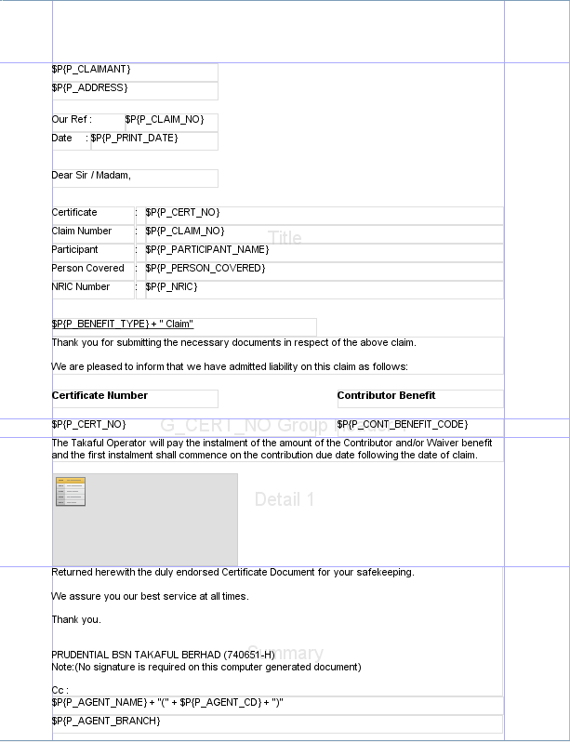
Jasper Development
There are letter templates that require to display a certain certificate number of a claim followed by the details of the certificate number. In the case of multiple certificate numbers under a claim, the following must be observed.
Since the top part of the letter will only be displayed once in the letter generation, it is appropriate to put it on the Title band which only appears on the first part of the letter.
To be able to handle multiple certificate numbers in a claim, the certificate number field is placed on a group named, G_CERT_NO so that every time there is a new certificate number, the G_CERT_NO Header will display it.
The details are always placed on the detail band.
The closing part of the letter shall always be placed at Summary band so that this part will only appear on the last part of the letter.

Slide 59
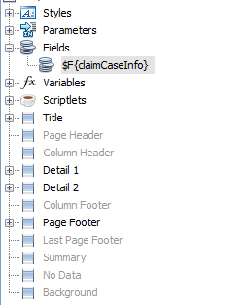
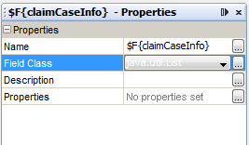
Jasper Development
For some letters requiring display of dynamic listing of objects. Using of a subreport is advisable.
The details must be placed in the detail band of the sub report using text fields created under the subreport’s fields.
Note : The fields created in the example are objects found in the claimCaseInfo class, thus we are utilizing the claimCaseInfo class on the following examples to follow.
Create a $F{claimCaseInfo} field in the main report with a field class java.util.List.

Slide 60
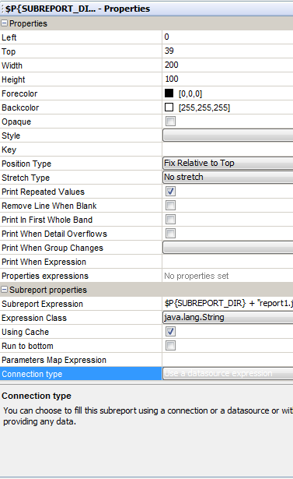
Jasper Development
Clicking on the sub report will display its properties on the right pane. Set the Connection Type to Use a datasource expression.

Slide 61
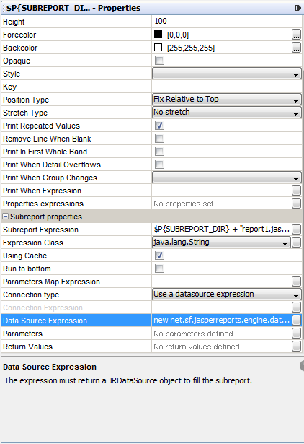
Jasper Development
On the datasource expression, add new net.sf.jasperreports.engine.data.JRBeanCollectionDataSource($F{claimCaseInfo})

Slide 62
Jasper Special Setting
Performance issue: PAMBPROD-1097
jasperreports.properties
Max page: 50
MaxPagesGovernor.PROPERTY_MAX_PAGES_ENABLED
MaxPagesGovernor.PROPERTY_MAX_PAGES
Import new font
calibri-font.jar
pru-sans-extra-font.jar
pru-sans-normal-font.jar

Slide 63
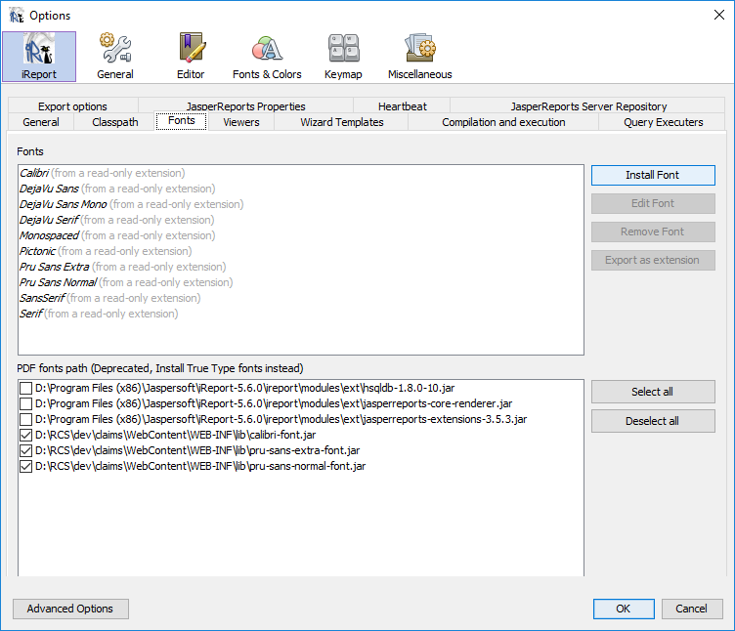
Import New Font

Slide 64
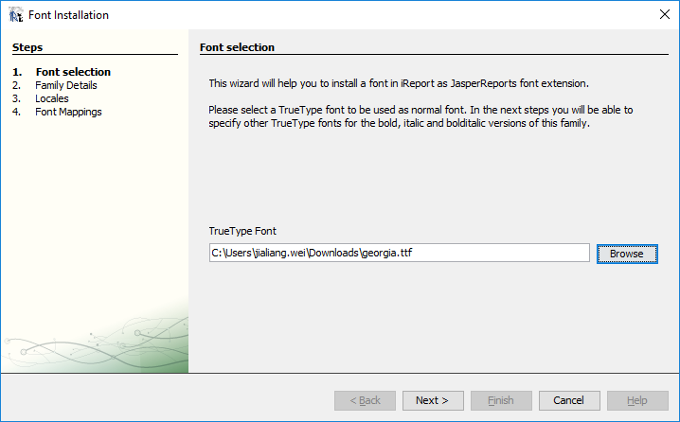
Import New Font

Slide 65
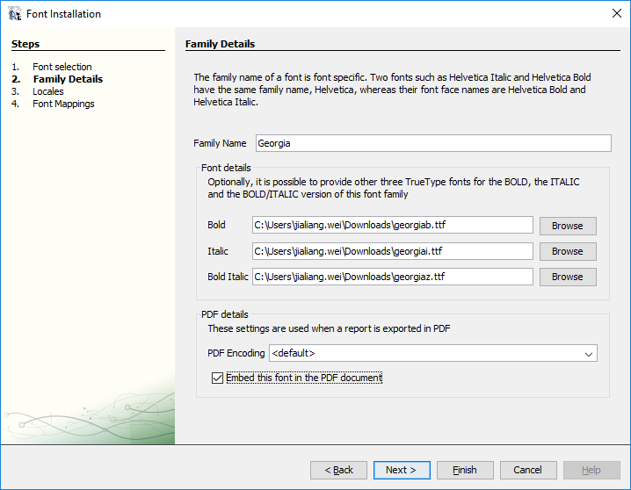
Import New Font

Slide 66
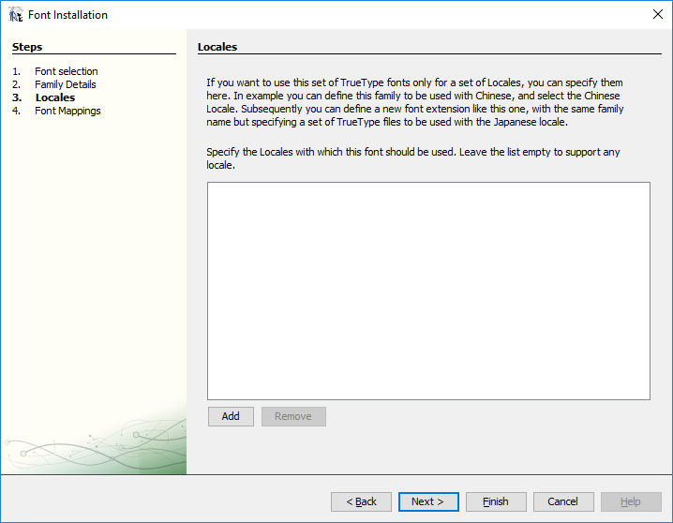
Import New Font

Slide 67
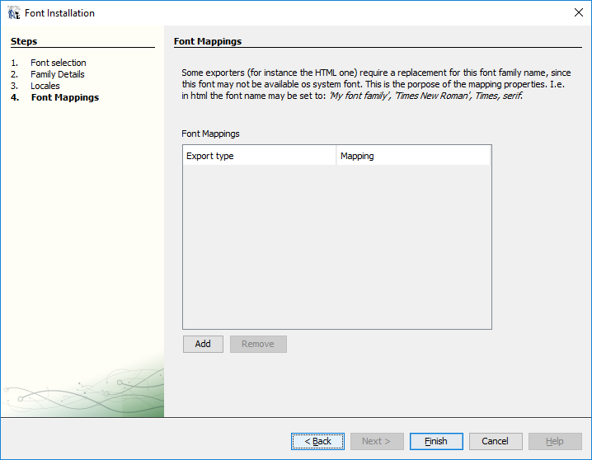
Import New Font

Slide 68
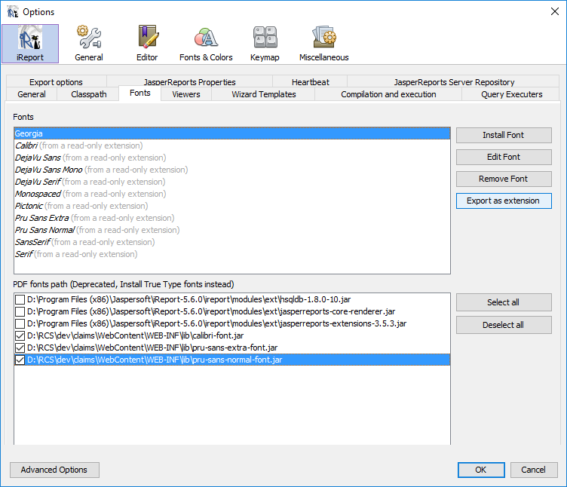
Import New Font

Slide 69
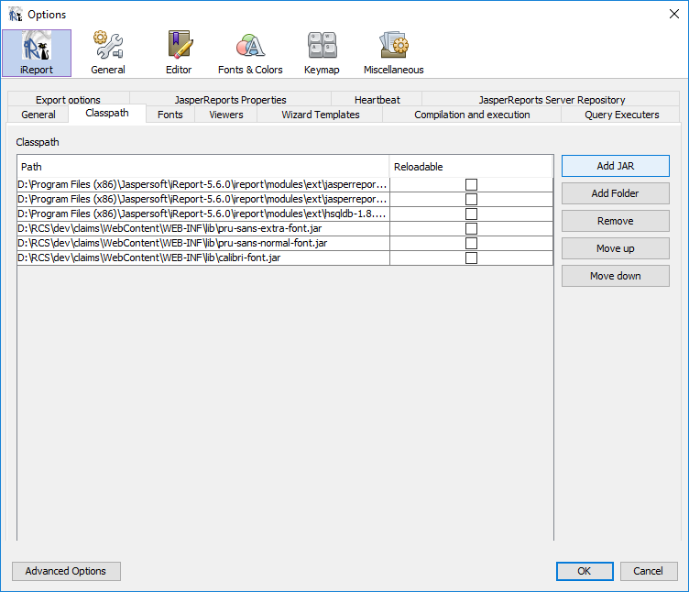
Import New Font

Slide 70
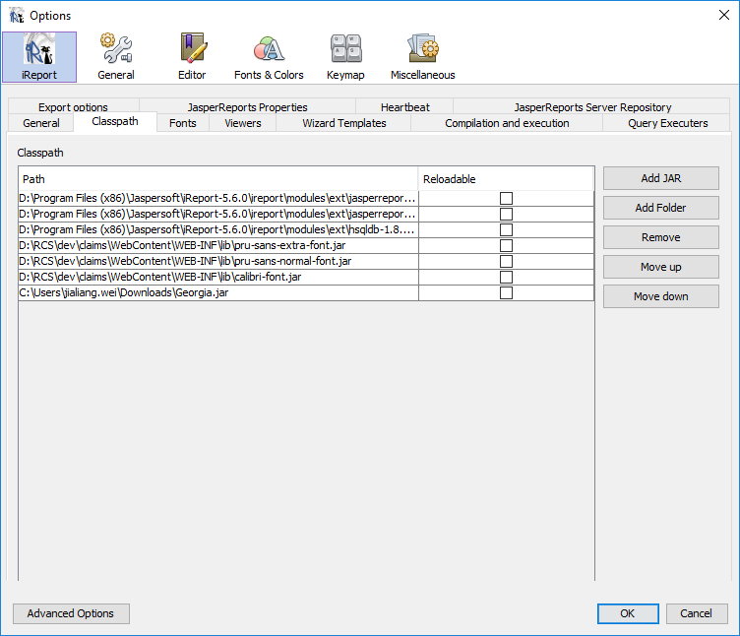
Import New Font

Slide 71
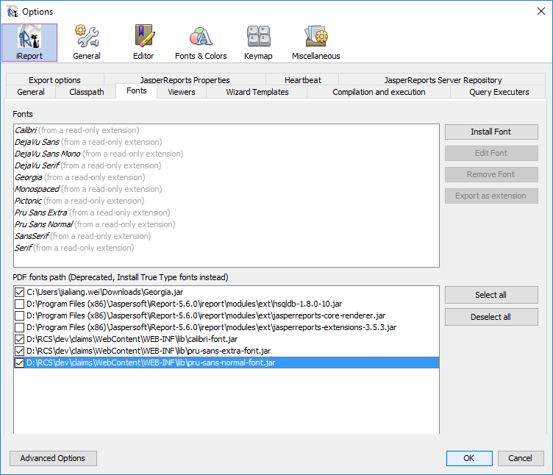
Import New Font

Slide 72
New Letter Development
In creating a new letter, below is a general list of files that must be updated / created. More files may be needed depending on the letter implementation.
User Trigger | Batch Trigger | Auto
Struts-config.xml: For action mapping Action class: For common online letter implementation Service class / methods: For data processing DAO class / methods: For data retrieval Jasper Templates: For the letter template reportLetterList.properties: For letter details needed for Letter UI dropdown list. This is only applicable if Letter UI is used reportLetter.properties: For document ID definition LetterUIFilter*.java: For the letter’s filter criteria based on requirement and claim type JSP file: For the letter-specific UI | Service class / methods: For data processing DAO class / methods: For data retrieval Batch trigger update: update BATCH table or DailyLetterBatchJobService reportLetter.properties: For document ID definition Jasper Templates: For the letter template | Service class / methods: For data processing DAO class / methods: For data retrieval Auto trigger update: update corresponding trigger operation service reportLetter.properties: For document ID definition Jasper Templates: For the letter template

Slide 73
New Letter Development
DeductibleNotificationLetterAction
LetterGenerationAction
ServiceForm
PDFHttpResponseHandler
LetterHandlingTemplate
OutputStreamTemplate
FilePathHandler

Slide 74
Auto Testing
PaymentLetterTPDBaseTest
PaymentLetterCCBaseTest
PaymentLetterDeathBaseTest
ClaimsRepudiationLetterBaseTest

Slide 75
Q & A

Slide 76
Execises

Slide 77
Thank you!

